Slide 1


USTelecom Industry Metrics & Trends 2020
APRIL 2020

Slide 2
Contents and Summary
Investment drives competition in broadband deployment, adoption, and innovation
  A light-touch regulatory policy environment, and targeted government financial support for broadband has encouraged more than $1.7 trillion in investment since 1996.
  The result has been near-nationwide broadband deployment, widespread adoption of innovative services, and significant progress in narrowing the digital divide.
Internet data traffic continues to rise rapidly, and the U.S. remains a global leader
  However, accommodating data traffic growth and maintaining U.S. International leadership will require policies that address our greatest communications and technology challenges while at the same time encouraging ongoing network investment.
  Wireline infrastructure is essential to next generation broadband and 5G wireless networks.
Competition and technological innovation define the communications industry today
  Consumers are choosing among a wide array of new internet-based and wireless communications services.
  Legacy regulatory structures must adapt to the new competitive dynamic.

Slide 3

Investment Drives Competition in Broadband Deployment, Adoption and Innovation
A light-touch regulatory policy environment along with targeted government financial support for broadband has encouraged trillions of dollars in investment leading to near-nationwide deployment, widespread adoption of innovative services, and significant progress in narrowing the digital divide.
3

Slide 4
Broadband Has Been a Competitive
Industry from Its Inception

Slide 5
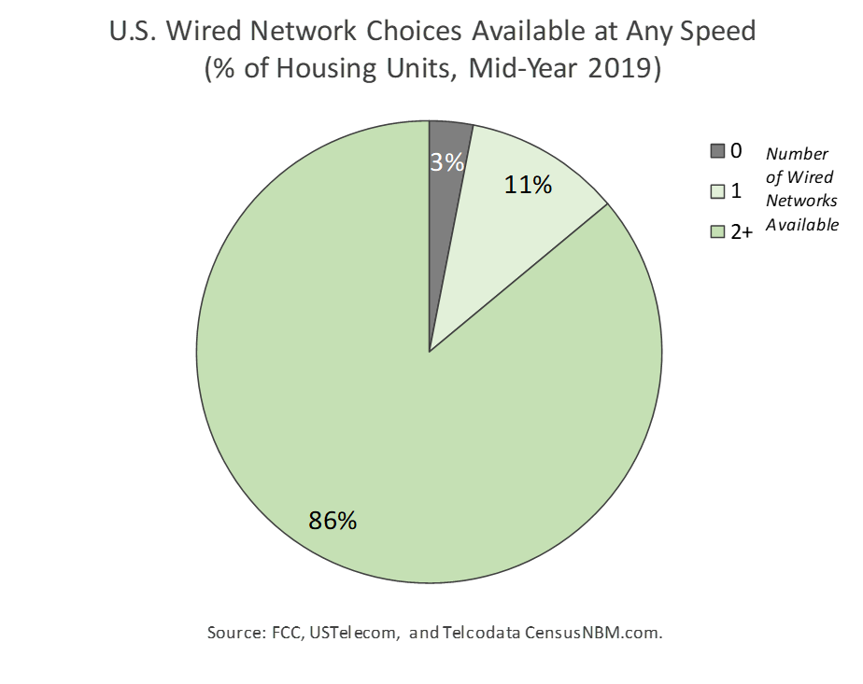
Competitive Network Infrastructure
Is Widely Available
This chart focuses narrowly on wired broadband competition for comparison with historical wired broadband data on page 17. Fixed broadband, which includes fixed wireless services, is shown on page 12 and has even greater competitive overlap among technologies.

Slide 6
Competition at Higher Speed Tiers Is Continually
Growing As Providers Invest in Network Upgrades
This chart focuses narrowly on wired broadband competition due to historical data limitations.
Fixed broadband, which includes fixed wireless services, would show even greater competitive overlap.

Slide 7
Broadband Providers Have Invested
More Than $1.7 Trillion in Capital since 1996
Data includes wireline, wireless, and cable providers.

Slide 8
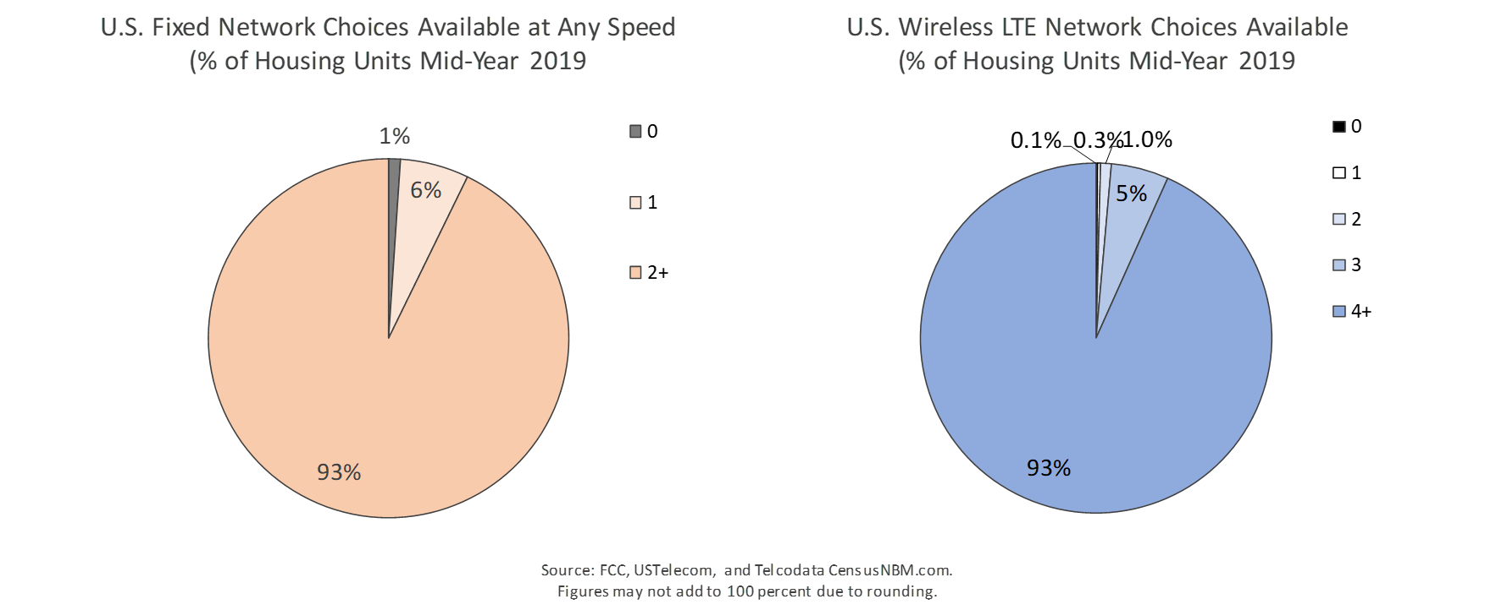
Network Investment by Competitive Providers Has Brought Near-Nationwide Deployment
Fixed broadband includes wired broadband and fixed wireless services, but excludes satellite. Wired broadband, excluding fixed wireless, is shown on page 6.

Slide 9
U.S. Invests More in Broadband than Most Industrialized Nations

Slide 10
U.S. Invests More per Capita in Broadband than Europe

Slide 11
U.S. Investment in Facilities-Based Competition
Has Yielded More Real Competitive Choice than Europe

Slide 12
Investment Has Enabled Widespread and Ongoing Broadband Adoption

Slide 13
Fixed Broadband Is Still Outpacing Household Growth and Approaching 85 Percent Penetration

Slide 14
Mobile Broadband is Growing Rapidly
U.S. smartphone adoption estimates range from 81% of adults (Pew Internet, June 2019) to 83% of households (Consumer Technology Association, First Quarter 2019)

Slide 15
Providers Are Deploying Networks Capable of
Providing Higher Speeds
In addition to wired broadband, 4G mobile broadband grew from availability of less than 1% of Americans in 2010
to 99.8% in 2018. 4G Download speeds are in excess of 20 Mbps (opensignal.com) and 5G deployment is underway.

Slide 16
Consumers Are Choosing Services with Higher Speeds

Slide 17
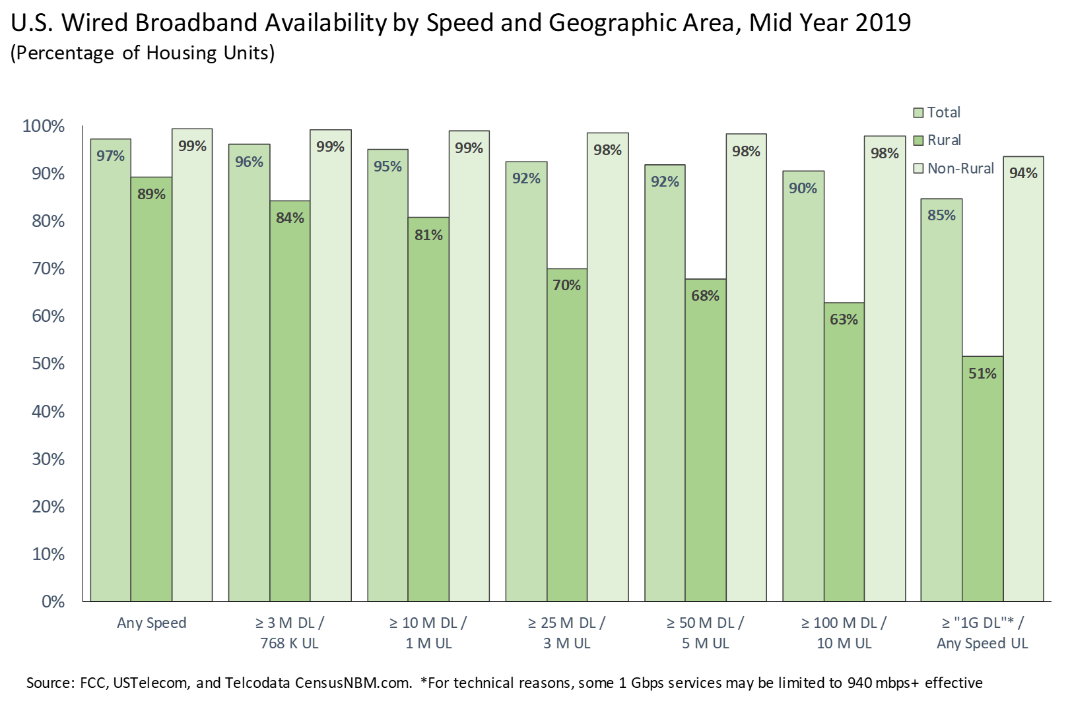
Broadband Gaps Remain in High-Cost Rural Areas
USTelecom supports direct, non-duplicative government support to broadband providers as the most economically and administratively efficient way to close broadband gaps

Slide 18
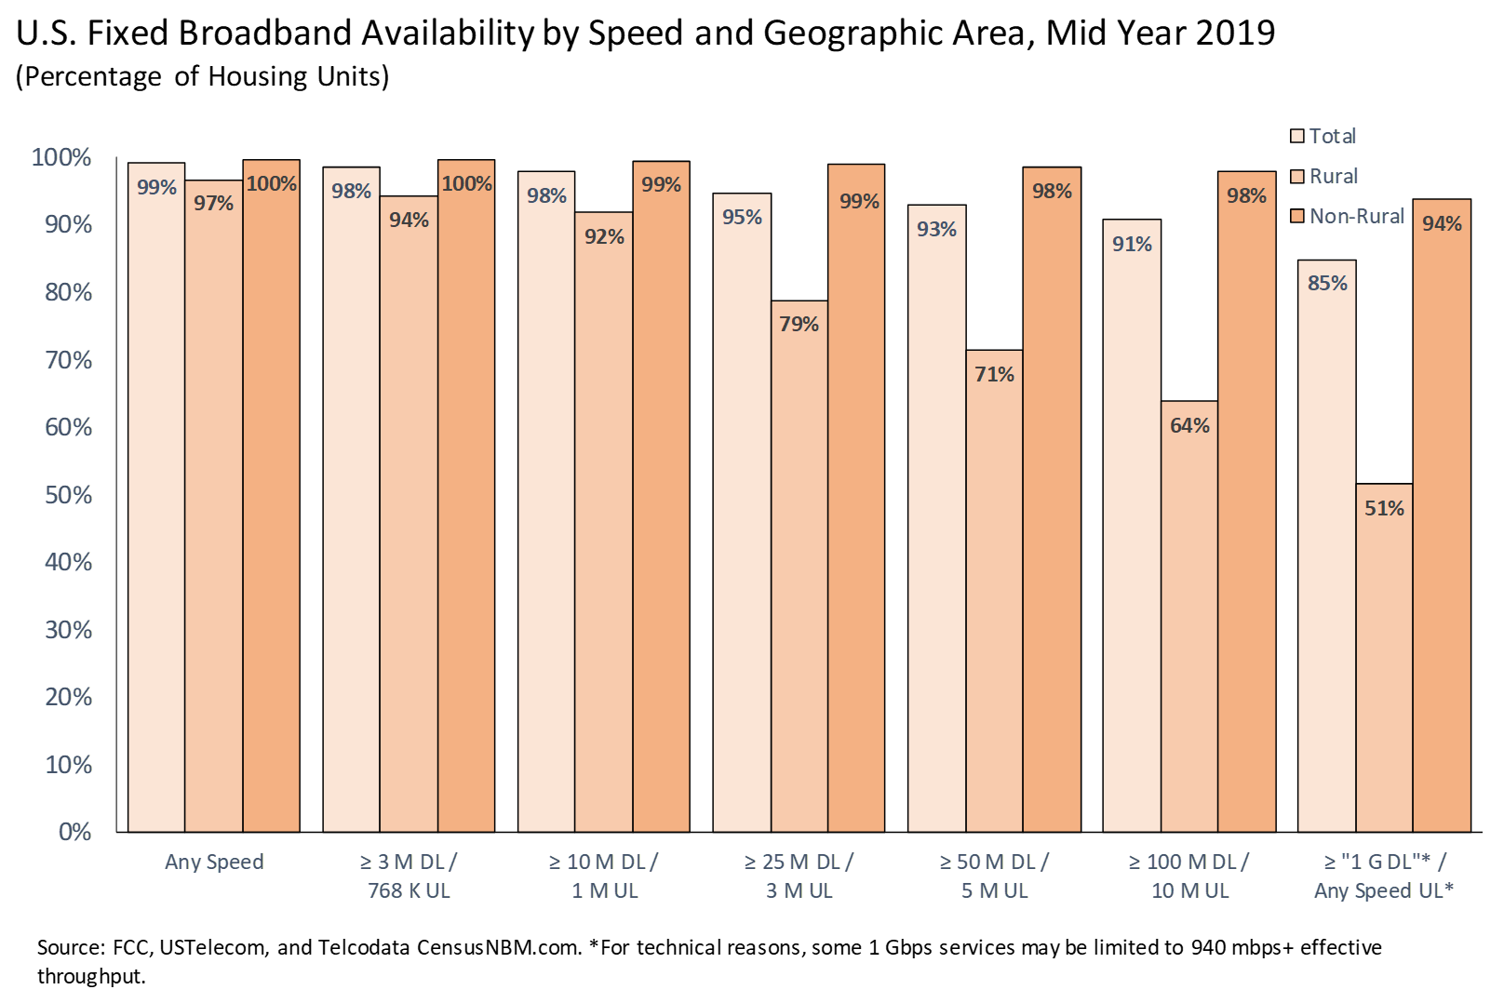
Fixed Wireless Eliminates Some Rural Coverage Gaps
These data include fixed terrestrial wireless
USTelecom supports flexible, cost-effective policies that do not impose rigid technology and speed requirements

Slide 19
Federal Universal Service Programs Are Connecting
Millions of Rural Americans to Broadband
The federal high cost program was $4.684b in 2018 compared to $4.673b in 2017. Many states have universal service programs that supplement federal funding. According to the National Regulatory Research Institute, in 2017 there were 22 states with high cost funds ($451m) and 8 with broadband funds ($122m).

Slide 20
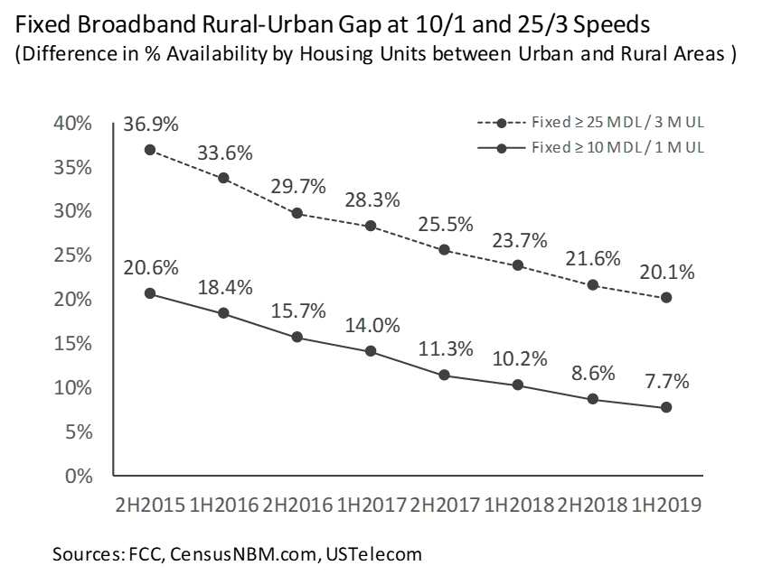
Rural Broadband Gaps Are Narrowing Due to Private Investment and Government Support

Slide 21
Broadband Capex Fell in 2015 and Resumed Growth in 2017 with Return to Light Touch Regulation
Addressing rural broadband gaps and maintaining international leadership will require increased broadband investment under an even-handed, light-touch regulatory framework.

Slide 22
The U.S. Is a Global Leader as Internet Data Traffic Continues to Rise Rapidly
Accommodating data traffic growth and maintaining U.S. international leadership will require policies that address our greatest digital challenges while at the same time encouraging ongoing network investment, including the wireline infrastructure that is essential to next generation broadband and 5G wireless networks
22

Slide 23
Internet Protocol Traffic Continues Rapid Growth
U.S. IP traffic is projected to grow 2.6x or an average annual growth rate of 21 percent in the next five years.

Slide 24
Video is the Largest Driver of IP Traffic

Slide 25
Downstream Traffic Represents a
Large and Growing Share of Traffic

Slide 26
Mobile and Wi-Fi Are Growing but
Fixed Networks Remain Essential for All Traffic
Wired networks are essential for nearly all traffic, including fixed and mobile, whether providing last mile access, backhaul for mobile cell sites or fixed wireless equipment, metro and backbone transport, or connectivity to data centers and content distribution networks; and Wi-Fi is merely a short-range extension of a fixed network.

Slide 27
The U.S. Is a Global Leader in IP Traffic
The U.S. is home to 4.3% of the world’s population, but it generates nearly one-third of global IP traffic.

Slide 28
North America Leads the World in IP Traffic per Capita

Slide 29
North America Leads the World in IP Traffic per User

Slide 30
The U.S. Leads Other Industrialized Nations in
IP Traffic per Capita

Slide 31
The U.S. Has Surpassed Former Leader South Korea and Now Leads the World in Internet Traffic per User

Slide 32
Competition and Technological Innovation Define Today’s Communications Industry as Traditional Systems Wain
While consumers choose among a wide array of new Internet-based and wireless communications services, legacy regulatory structures must adapt to reflect the new competitive dynamic
32

Slide 33
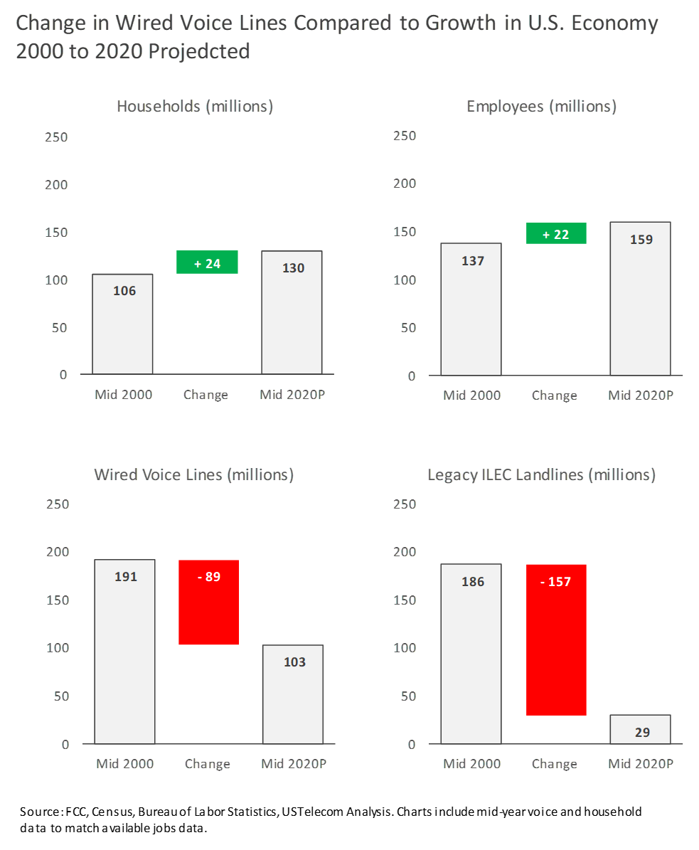
Even as the Economy Grows, Wired Voice Is Declining
As a Result of Competition and Technological Change
Since 2000, the U.S. has added 24 million households and 22 million jobs
Yet, dedicated wired voice lines have fallen by 89 million during the same period
Legacy landlines have been hit the hardest, falling by 157 million, as consumers switch from traditional phone service to competitive wireless and Internet-based alternatives
Source: FCC, Census, Bureau of Labor Statistics, USTelecom Analysis. Charts include mid-year voice and household data to match available jobs data.

Slide 34
Legacy Landline Voice Connections Are In Steep Decline

Slide 35
Wired Voice Customers Are Leaving Legacy Landlines for Competitive and Internet-Based Alternatives

Slide 36
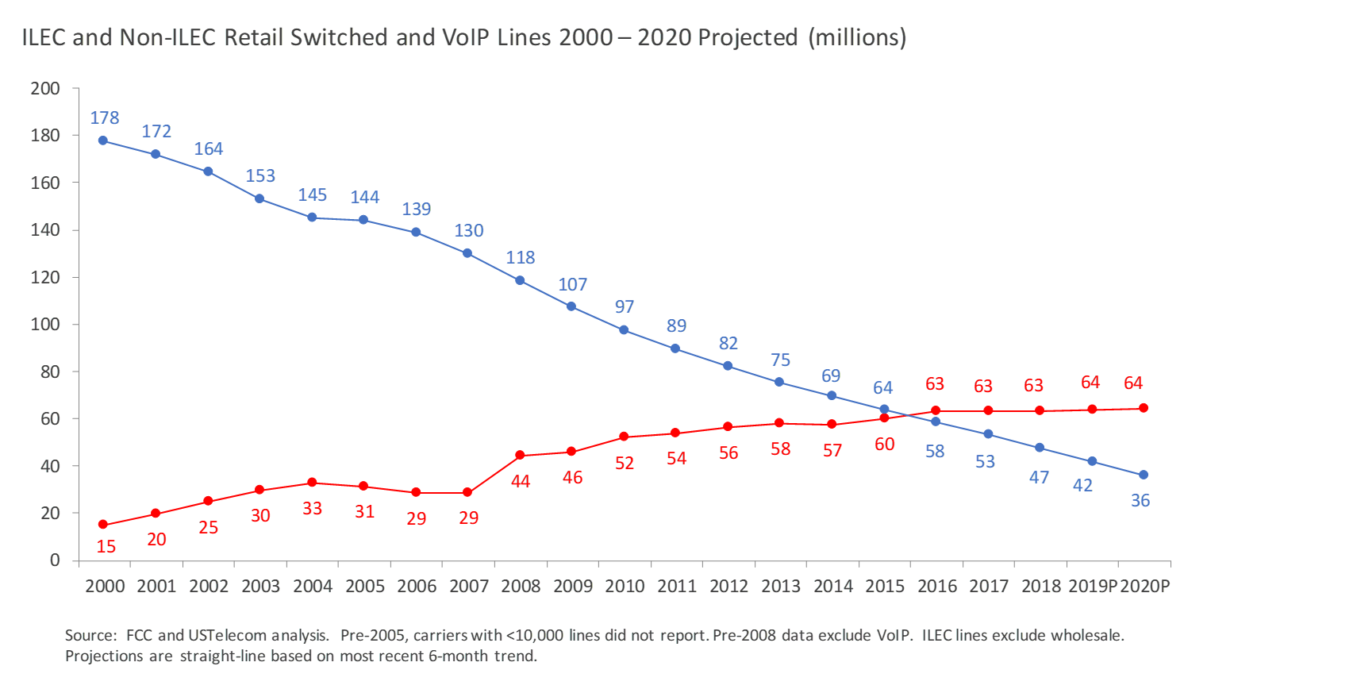
Non-ILECs Surpassed ILECs in Wired Voice
Nearly Five Years Ago

Slide 37
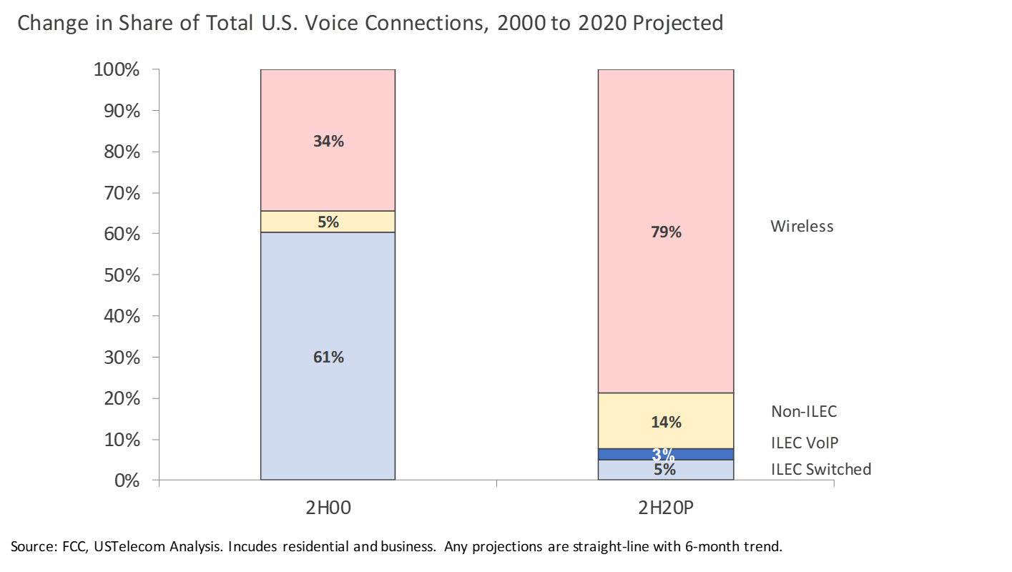
Nearly Four-Fifths of
U.S. Voice Connections Are Wireless
Legacy
Landline
Voice Will
Fall to 5% of Connections by
the End of 2020

Slide 38
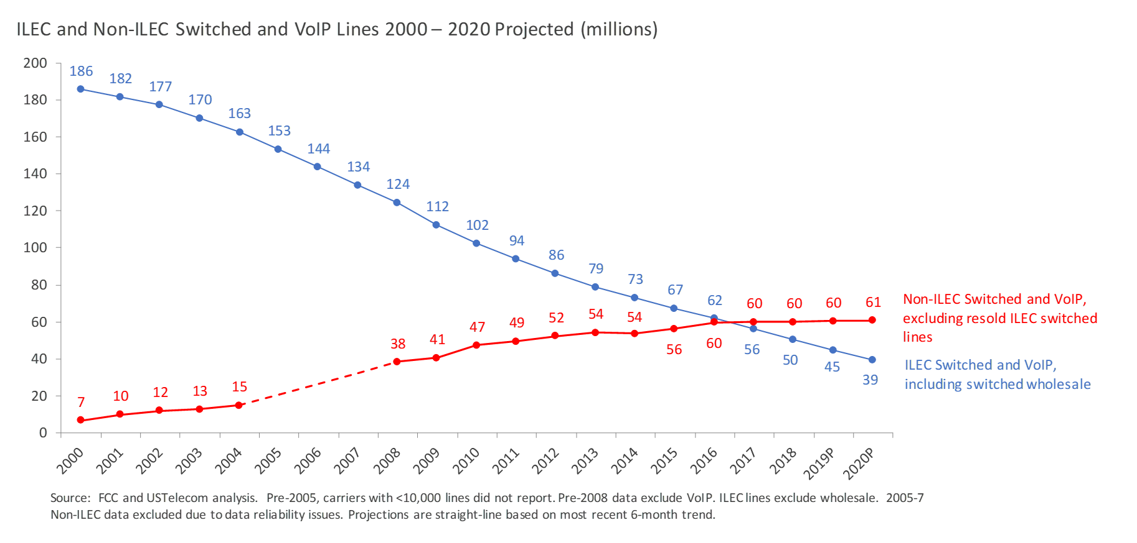
Non-ILECs Have Surpassed ILECs in Wired Voice
Even When Attributing Wholesale Lines to the ILEC

Slide 39
The Vast Majority of U.S. Households Have Moved from Legacy Landlines to Wireless or IP Voice

Slide 40
Notes on Data and Sources
  Data and projections: Unless otherwise noted, the data in this presentation are based on sources that are current through mid-year 2019 for broadband deployment, year-end 2018 for voice connections, and year-end 2017 for broadband connections and Internet traffic . Projections are denoted with a “P”. In the first and third sections, projections through 2020 are USTelecom straight-line estimates based on the most recent 6-month trends. Accuracy of projections is not guaranteed and may depend on factors such as level of aggregation, technological maturity, seasonality, and adoption curves. In the second section, Internet traffic projections are provided directly by our source.
  Terminology: As used in this presentation, broadband includes fixed and mobile services. Mobile broadband is provided over cellular wireless networks. Wired broadband is a subset of fixed broadband and predominantly includes services using fiber, DSL, and cable technologies. Fixed broadband includes wired broadband plus fixed wireless and, sometimes, satellite. The broadband deployment data below exclude satellite from fixed broadband while the broadband connections data include satellite in fixed broadband.

Slide 41
Additional USTelecom Research Resources
USTelecom Research Brief: U.S. Broadband Availability Mid-Year 2018
(November 14, 2019)
USTelecom Research Brief: U.S. Broadband Availability Year-End 2017
(July 31, 2019)
USTelecom Research Brief: Broadband Investment 2018
(July 31, 2019)
USTelecom Research Brief: U.S. Internet Usage and Global Leadership Are Expanding (November 27, 2017)
Tony Clark and Monica Martinez: Redefining Legacy Obligations: The More Things Change, the More Things Need to Change (September 20, 2019)

