Slide 1
Using Existing Technology to Power the Communication of Tomorrow
May 13, 2021

Slide 2





introducing
Karl Whitlock
Sharon Dileo
Chris Bain
Research Vice President, Communications Service Provider Operations and Monetization (OSS/BSS)
Director
Product Management
Director
Common Language Services

Slide 3
Using Existing Technology to Power the Communications of Tomorrow (5G, Edge Computing, Virtualized Networking and More)
Karl Whitelock, VP Communications Service Provider Operations and Monetization
May 13, 2021

Slide 4
Agenda
Industry Trends
Service Provider Business Challenges
How Common Language Helps

Slide 5










People, Things, Business Solutions and …
Millions of devices
Multiple industries
  Enhanced video
  AR / VR
  Cloud Gaming
  In-vehicle connectivity
  Advertising
  Industrial 4.0
New CSP partners
  Hyperscaler cloud providers
  App developers
  Enterprise B2B content partners
And →
People and Things

Slide 6
New Connectivity Capabilities
RAN, transport and core network (5G NSA, 5G SA) evolution
“Softwareized” network functions (PNF→VNF, CNF)
Network slicing
  Personalized virtual networks using the same physical assets
  Slices can grow into the hundreds+
Hyperscaler Cloud Provider (HCP)
  Multi-Access Edge Computing (MEC)
Increasing fiber access buildout
LEO satellite and Wi-Fi 6 broadband roaming with 5G cellular
Existing physical network nodes and services – PSTN
What next???

Slide 7
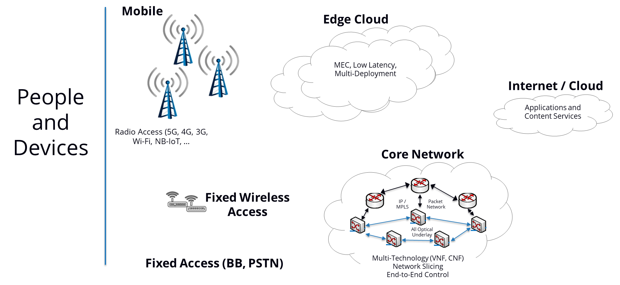
Network Technology Evolution

Slide 8
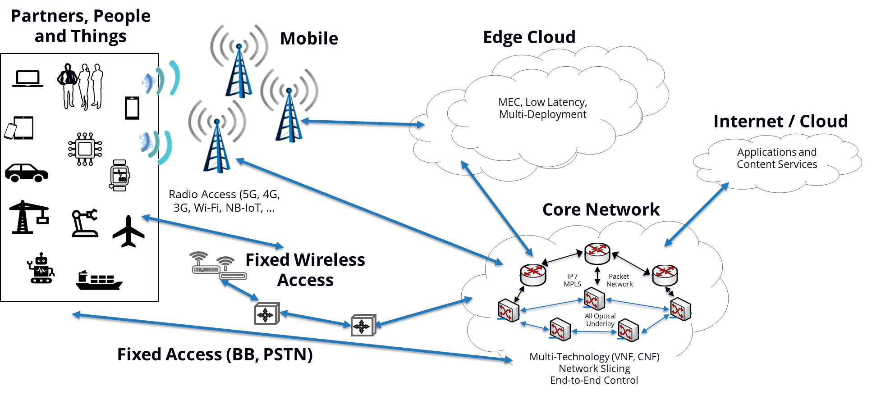
Integrated Network and Partner Ecosystem

Slide 9
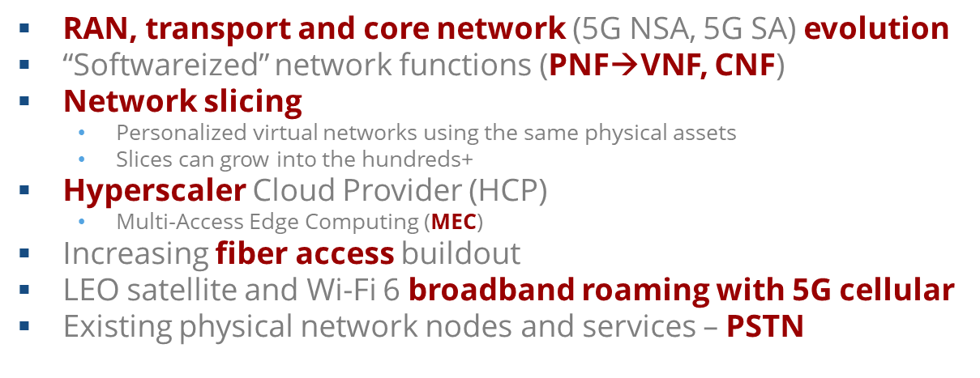
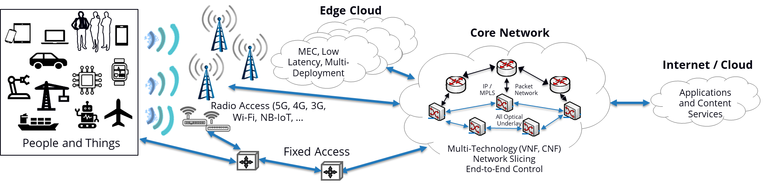
Multi-Technology Complexity and Operations
What will facilitate this new stuff?
The evolving network

Slide 10
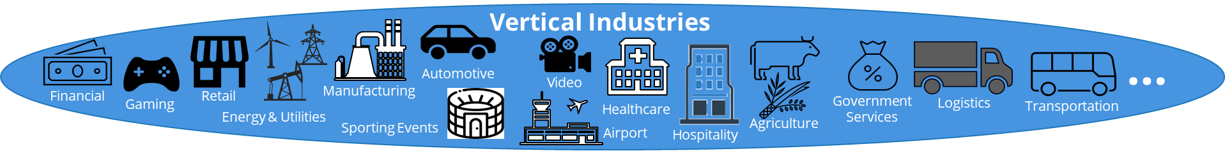
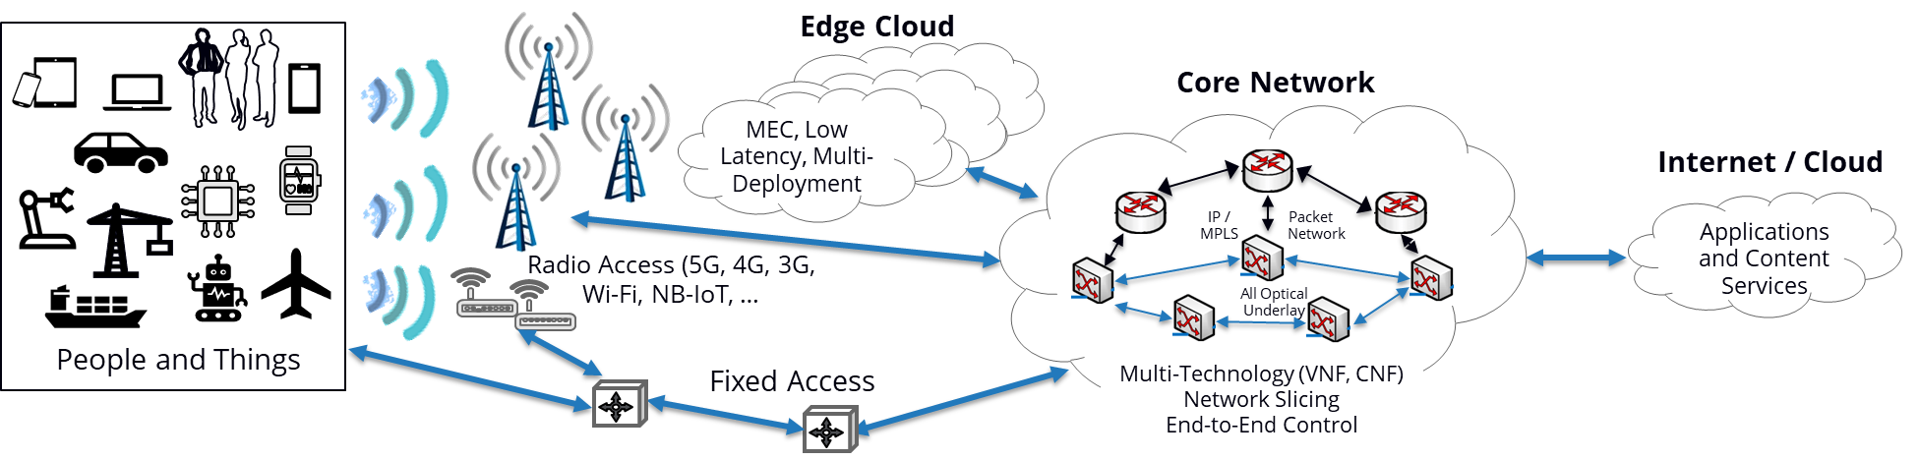
Operational Complexity
Something Is Missing

Slide 11
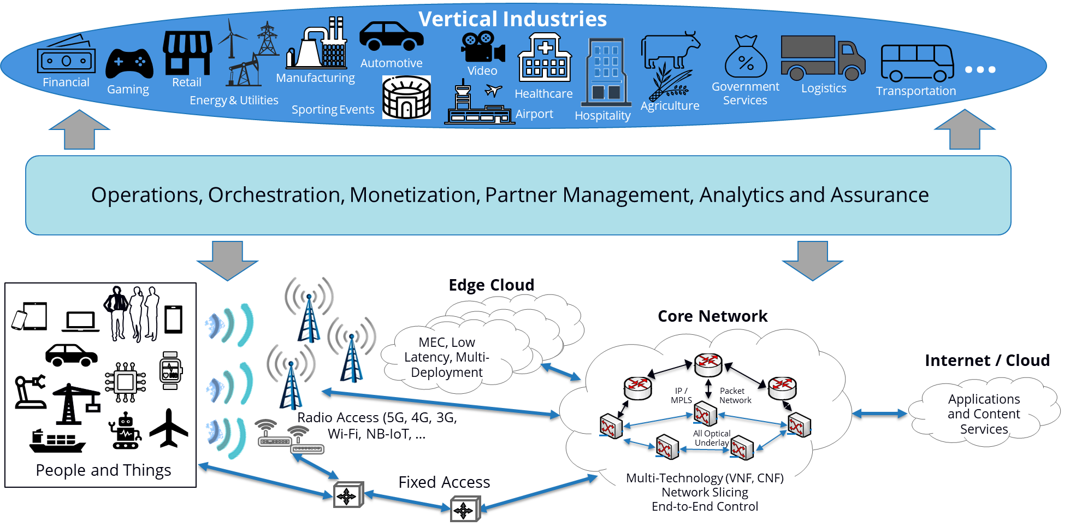
Operations and Asset Management

Slide 12
CSP Business Challenges
Network as a Service (NaaS) expectations
  Enterprise NaaS
  CSP NaaS
Real-time operational demands
  Changing network and service conditions
  Changing customer service demand
  E2E Multi-network service management (5G slicing)
  Dynamic inventory and asset management (physical and virtual)
Revenue accountability and partner remuneration
Inflexible operations and monetization IT environment

Slide 13
Why Common Language Helps
Operational planning and implementation
Cross organizational asset identification
New service/solution definition
Existing Solution evolution (where and what)
Simplified financial and regulatory accountability

Slide 14





5G is now
change in the services now available
new business opportunities
increased volume of data and demand for improved service

Slide 15
Poll question 1
When it comes to 5G deployments, what is your main focus?
Strategic vision
Use case development
Network readiness
Gathering insights

Slide 16

time to reimagine everything you think you knew
managing the digital transformation
wide-scale changes in
network infrastructure
increased need for more timely coordination and tracking
minimizing errors
significant growth in locations, functionality at locations, and equipment that supports the functionality
connections need increased throughput for new service offerings
strategic to internal operations
  virtual functions
  software licenses
  service orchestration
  finance software
  latency reduction
  rating and billing

Slide 17
Poll question 2
On the business side, what is keeping you up at night when it comes to supporting 5G?
Time to market
Resources to support new service rollouts
Competitive threats
Managing network complexities

Slide 18

5G transition implications
network changes are not isolated
failure to effectively manage network and services may result in:
engage and contract with multiple vendors
effective management of physical and virtual assets
develop and deploy new use cases
seamless interworking between providers
potential loss of market share
large impact to the network
increased risk of ambiguous communication of information

Slide 19


5G is leveling the playing field
There is a lot at stake and a lot of players are fighting for their piece of this market
incumbents could lose market share
new entrants are breaking into this space
smaller service providers have opportunities to compete in ways not previously possible.
all must be able to speak the same language
growth will come from partnerships
not just about technology, several key business drivers
Common Language provides equal Command and Control capability for all users

Slide 20
Poll question 3
On the network side, what is keeping you up at night when it comes to supporting 5G?
Rapid service introduction
Latency
Capacity
Interconnection

Slide 21
managing the complexity is possible
major role
information enrichment
benefits
facilitates accurate communication of critical information
helps interworking parties in the entire ecosystem “speak the same language”
definitively identifies shared information
successful long-standing customer implementations
5G Open Innovation Lab
evolutionary role in seamless interconnection
provides organizations a means to identify and track the physical placement and virtual usage of communications infrastructure

Slide 22





seamlessly manage new network-based services
location
connection
Common Language Location Identifier (CLLI)
Common Language Connection Codes
standardized global registry of locations
reference data defining possible connection configurations
equipment
service
Common Language Equipment Identifier (CLEI)
Common Language Information Services
registry of network equipment, software and licenses
reference data defining possible product, service offerings

Slide 23
industry standard: evolution of Common Language
code extensions
code extensions
International
GIS Data Inclusion
5G
6G
Session Border Controller
DWDM
Virtualized
Elements
NA GIS Data Inclusion
Wi-Fi Hotspot
CLLI
Location
Carrier Interconnection
Carrier
Ethernet
1.0
LTE Broadcast
4G access
(eNode B, DAS)
xDSL
OTN
PON
CLCI / CLFI
Connection
V2X
NC / NCI
Local Service
Network Channel / Network Channel Interface
SONET
Carrier
Ethernet 2.0
Virtualized
Functions
Downloadable Software
ROHS Class Added
Licenses
CLEI
Equipment
Product Change Classification
2D Label and MIB
SDN Classification
1980
1990
2000
2010
2021
code extensions
events
code extensions
ATIS
ASOG
EU Hazardous Class
oneM2M
GSA 2020
3.5 GHz
Regulation & Standards
Telecom Act (1996)
MEF Established
NiCode
Established
IMT-2030
Circuit
Switch
Carrier Grade IP
Metro Ethernet
NFV
AMPS
Synchronous Network
Packet
Switch
Public WIFI
Technology
Fast Access
Operator Services
Wireless
Bidirectional CATV
CLEC Explosion
Utility Fiber
Data Center
LTE
Cloud
Small Cell
Notes:
Speaker Notes: Our heritage helps us understand complexity; our expertise helps Service Providers evolve and meet new challenges.
While NFV is relative new technology, the challenges that accompany its widespread deployment are nothing new to us.
Common Language was developed in the early 1970’s to foster Service Provider collaboration through seamless interconnection. Since then, the product line has continuously evolved to meet ever-changing customer needs, service portfolios, technology requirements, and regulatory standards.
While the network has continued to evolve, our mission remains the same – to help Service Providers effectively collaborate, achieve efficiencies, and simply and seamlessly adapt their network infrastructure to meet changing needs.

Slide 24
TruOps Common Language Information Service
Years of experience in interconnection data registries and ANSI maintenance agent responsibilities
40+
Common Language’s Information Service standardizes locations, equipment, connections and service information within and in support of interconnection among service providers.
14.5M
Location Codes and Identified functions
7.8M
Possible Orderable Connections Configurations
94M
Daily Connections Managed
3.3M
Configurable Service Components
590k
Equipment Items, 1K+ Vendors

Slide 25


enabling a foundation for interconnection
5G is providing new opportunities for growth and increased revenues
growth will bring challenges in managing the network and interconnection
supports the fastest and most cost-effective way to help rollout new revenue-generating services

Slide 26


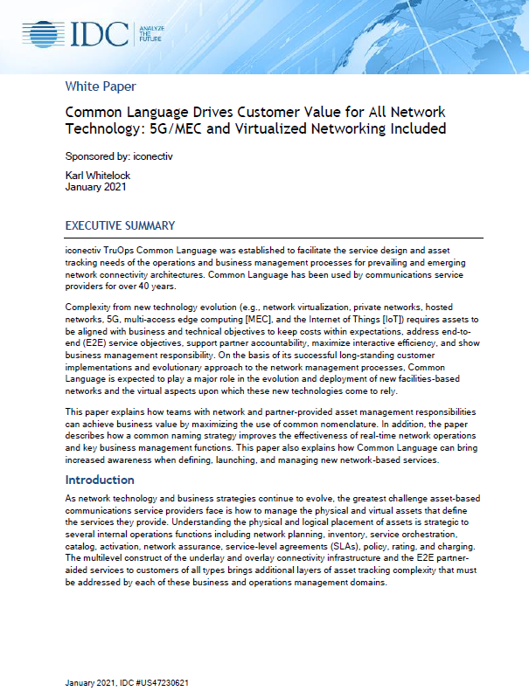
develop a deeper understanding
IDC Whitepaper Addresses the Challenges of Cost Effectively Deploying 5G at Scale
discusses how TruOps Common Language will play a larger role in supporting 5G rollouts
still plays vital roll supporting ongoing operations and maintenance for existing networks

Slide 27



questions & answers
www.iconectiv.com
@iconectiv
iconectiv

